Slide 1
GROUP A
Group Members:
Niral Makadia
Rashu Mangal
Rohit Pallay

Slide 2
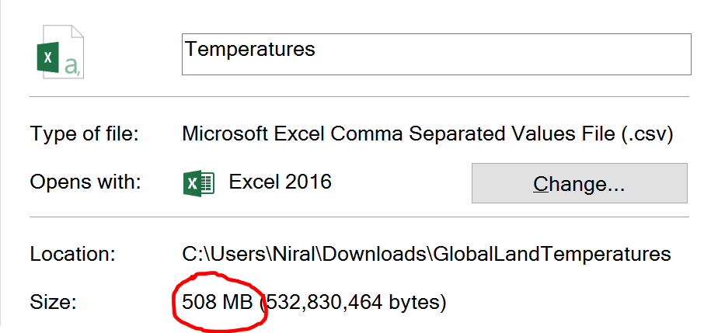
Data
Temperature Records over the past 200 years of almost all the cities around the world.
Uncertainties in Temperature given for each region.
Latitude and Longitude defined for each listing given in the data summing up the data size to be 508MB.
Total data points in the given raw data : 1,048,576

Slide 3
Data Source Link
Data retrieved from a website Kaggle.com which allows us to explore and analyze high quality public datasets.
Link for our dataset:
https://www.kaggle.com/berkeleyearth/climate-change-earth-surface-temperature-data

Slide 4
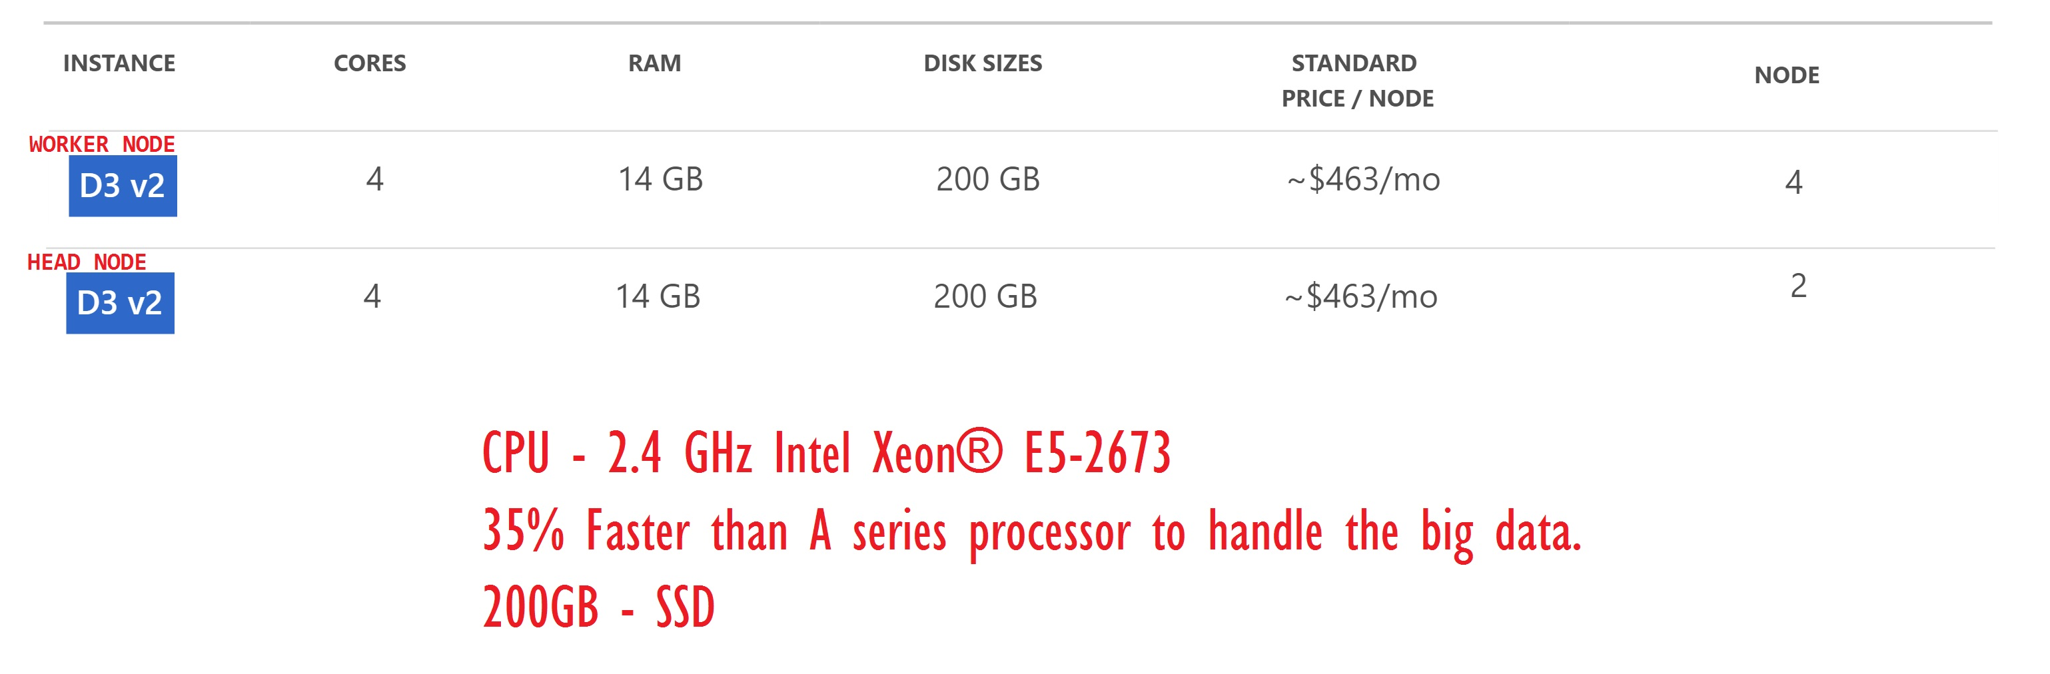
Specifications

Slide 5
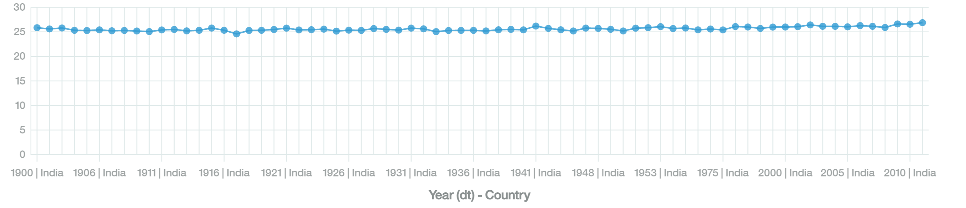
Visualization of Data for India
The graph shows average temperature readings for all the years from
1900-2013 for all the states of India.
As the graph show the readings start from 25.83 ̊c in 1900; ends at
26.86 ̊c in 2013 which shows a variation of 1.03 ̊c over past 100 years.

Slide 6
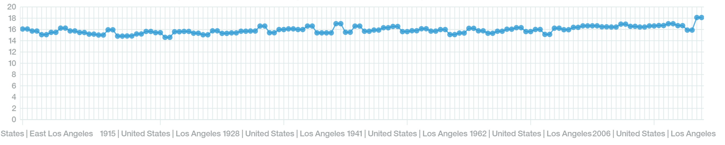
Visualization of Data for Los Angeles
The graph shows average temperature readings for all the years from
1900-2013 for Los Angeles, United States.
As the graph show the readings start from 16.08 ̊c in 1900; ends at
18.12 ̊c in 2013 which shows a variation of 2.04 ̊c over past 100 years.

Slide 7
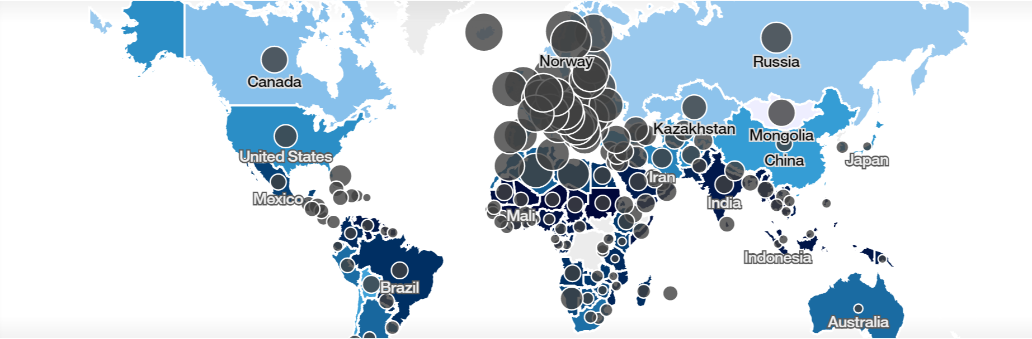
Temperature Uncertainties for all Countries
The size of the Black Bubble on the map shows the actual values of Temperature Uncertainty in all the countries.
The bigger the bubble the higher temperature varies in that country compared to the average temperature.

Slide 8
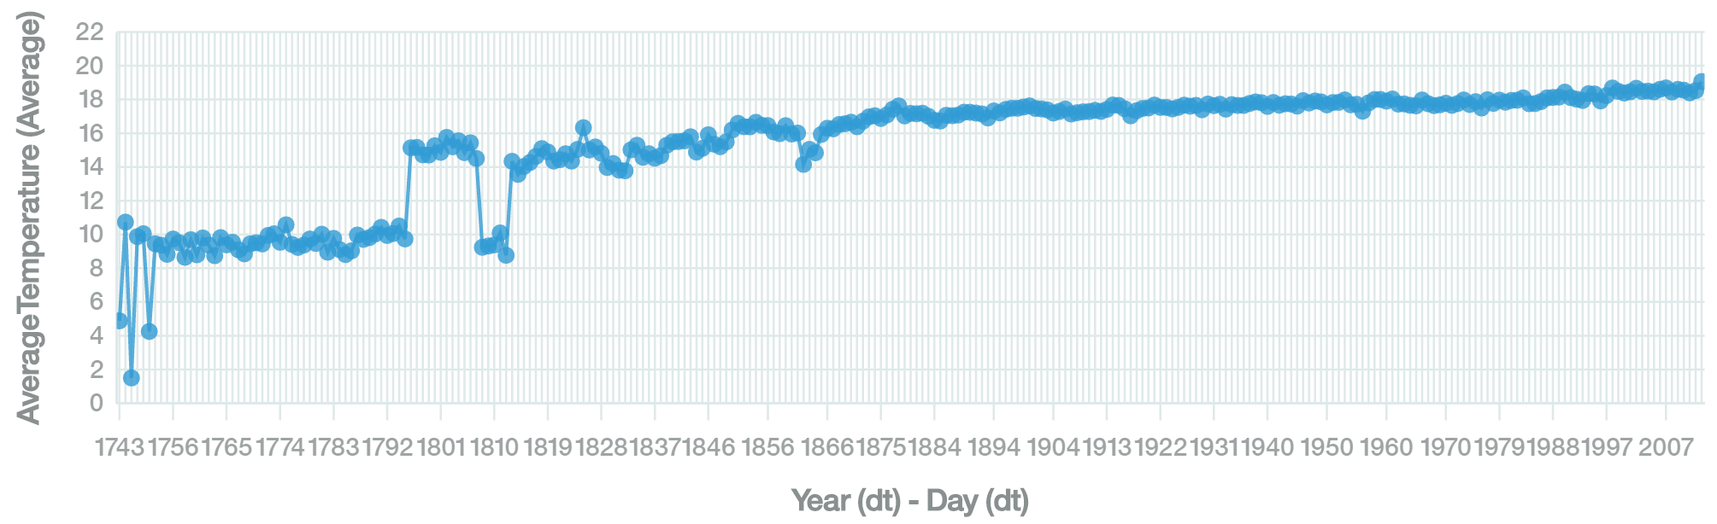
Changes in Temperature all over the World over the past 300 years

Slide 9
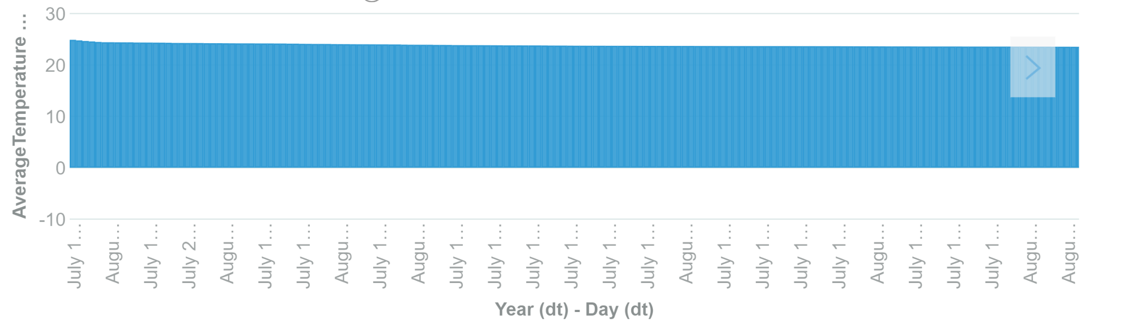
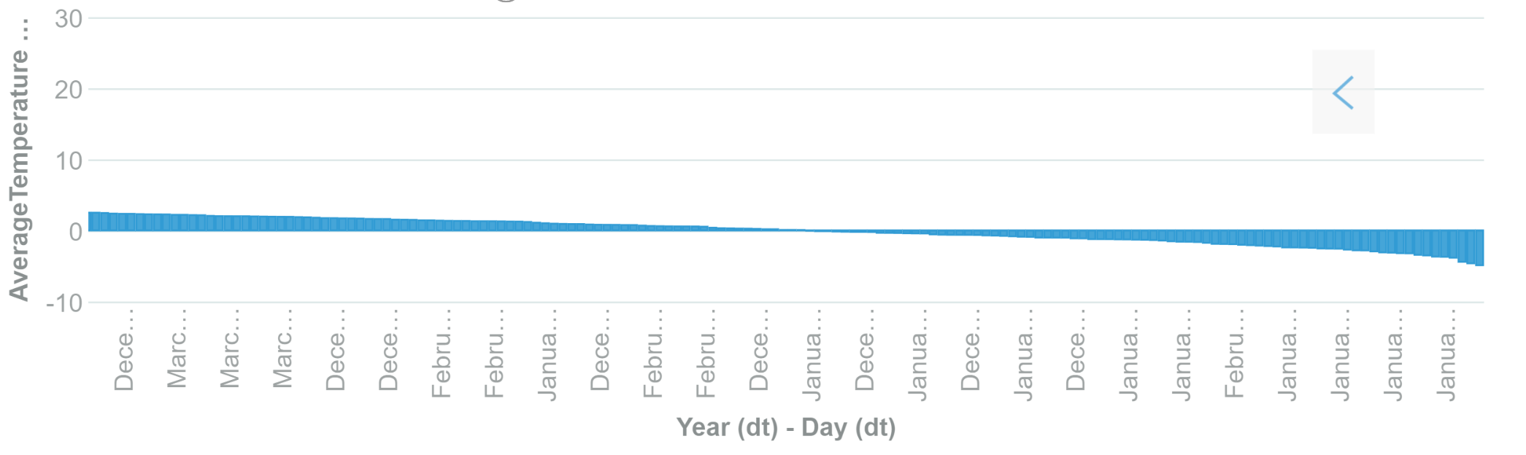
Temperature Patterns: Month-wise for all Countries

Slide 10
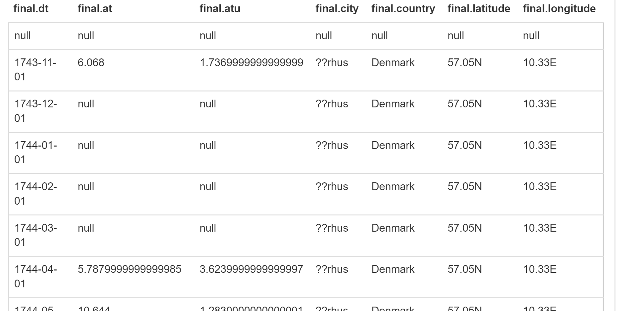
HIVE Queries
SELECT * FROM final;

Slide 11
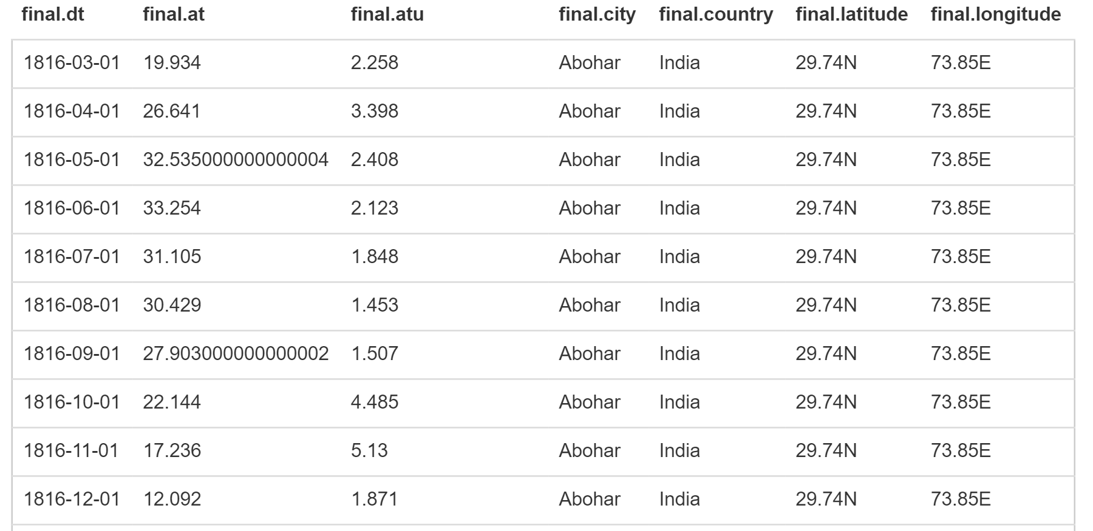
HIVE Queries
select * from final WHERE FINAL.COUNTRY="India";

Slide 12
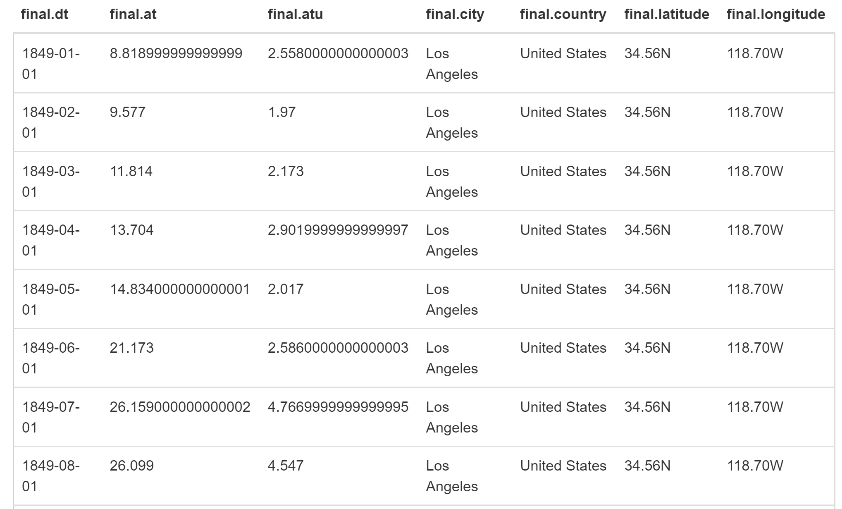
HIVE Queries
select * from final WHERE FINAL.COUNTRY=“United States" and FINAL.CITY=“Los Angeles";

Slide 13
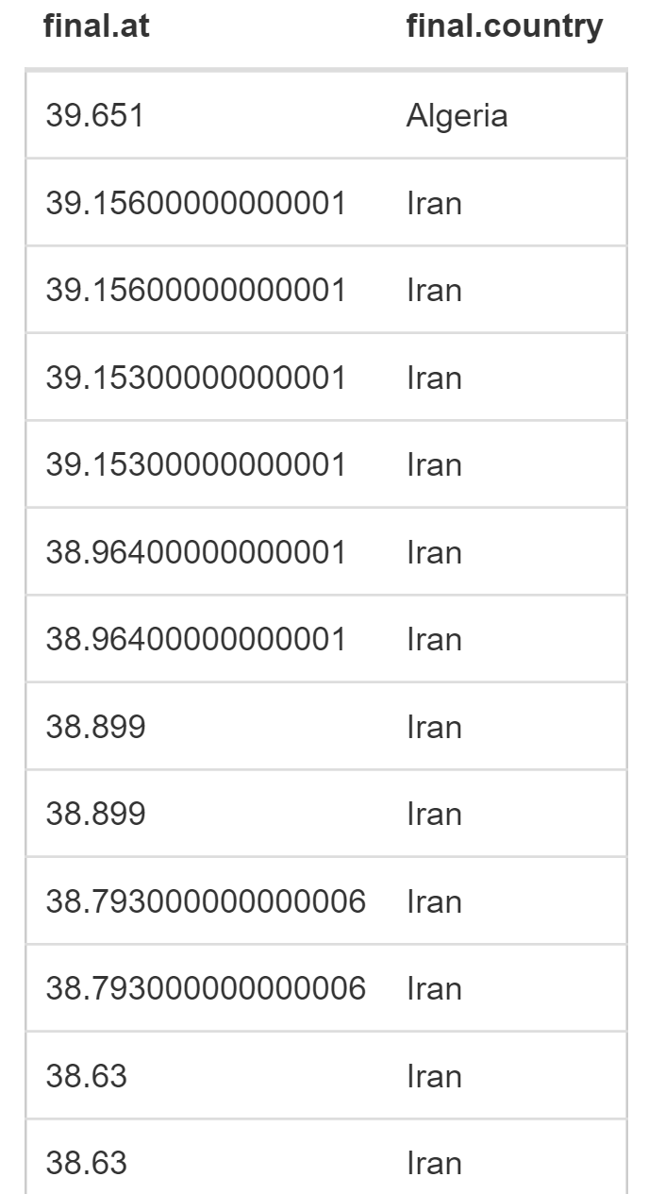
HIVE Queries
select final.at, final.country from final ORDER BY final.at DESC;

Slide 14
GITHUB
https://github.com/niral0001/520-Final
CREDITS:
KAGGLE
PROF. JONGWOOOK WOO
OUR TEAM MEMBERS

